Slide 1



Developer’s Guide

Slide 2

Location
Code Location
Source https://github.com/Promantus-dev/PROACC_2.git
SQL DB
IP: 54.210.14.251,14843 U:Sa P:Promantus@123 DB:PROACC2DEV

Slide 3

AZURE DEVOPS CI/CD
Current code Location
https://dev.azure.com/manogekumar/PROACC2
Current admin access
adinesh@promantus.com
manogekumar@promantus.com
Repos
Code Repo https://manogekumar@dev.azure.com/manogekumar/PROACC2/_git/PROACC2
DB Repo https://manogekumar@dev.azure.com/manogekumar/PROACC2/_git/PROACC2DB
In this location, we can able to build and deploy end-to-end to different servers. Here I have implemented 4 different release pipelines (DEV, QA, PRE PRO, Release)
SERVERS:
We are deploying in two different servers
Local or development server (PROIIS) (DEV, QA)
AWS (PRE PRO,Release)
RDP
PROIIS IP → 54.210.14.251
AWS IP → 54.197.178.237

Slide 4
Index
Admin
Project Manager
Consultant
Customer

Slide 5
Admin
Dashboard
User Settings
Configuration
Miscellaneous
Reports
PROACC Survey Mail

Slide 6

Dashboard

Slide 7
Dashboard
Dashboard Top Row → Home Controller → Store procedure SP_Dashboard
To Type :GetDasboard_Top

Slide 8
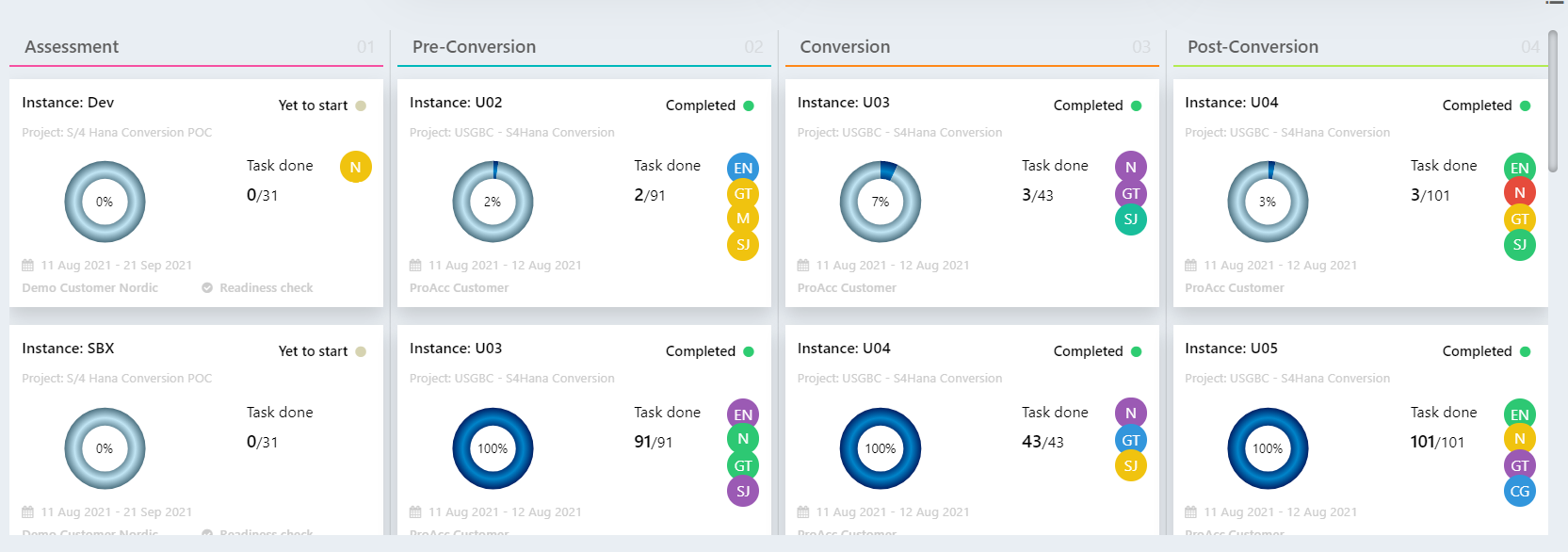
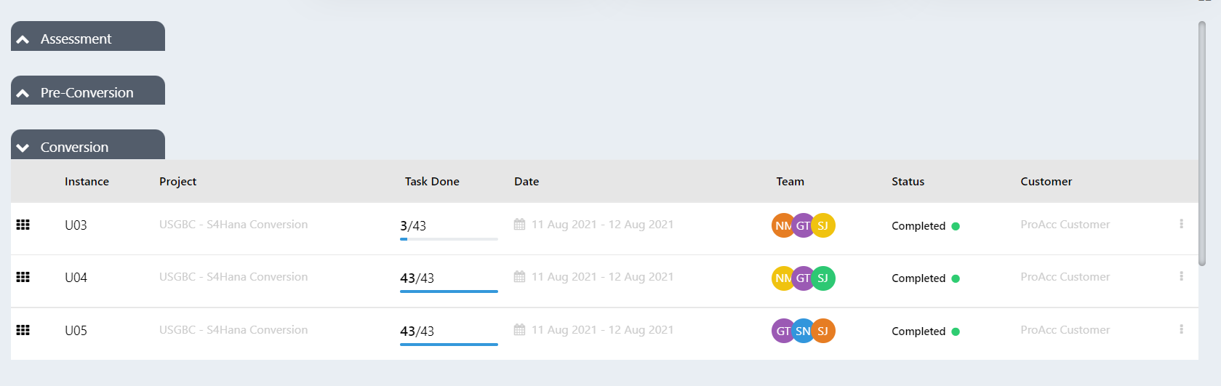
Dashboard
Dashboard Top Row → Home Controller
→ Store procedure SP_Dashboard
To Type :GetDasboard_Donut

Slide 9
User Settings

Slide 10
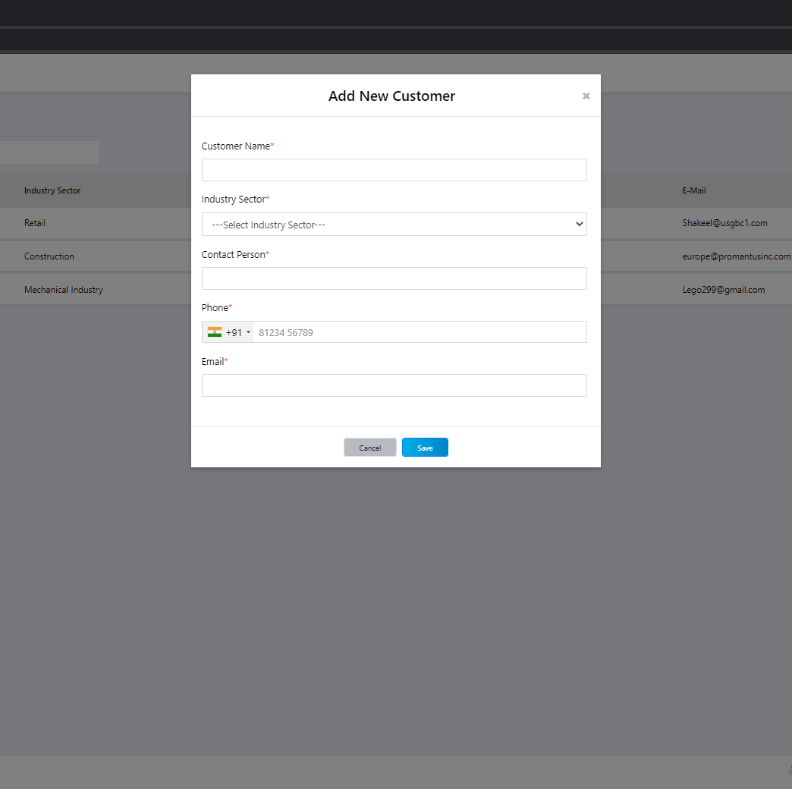
Customer Creation
Add , Update & Delete Customer → Admin Controller → Store procedure SP_Customer
To Add Type :CustomerCreate
To Update Type :CustomerUpdate
To Delete Type :DeleteCustomerById

Slide 11
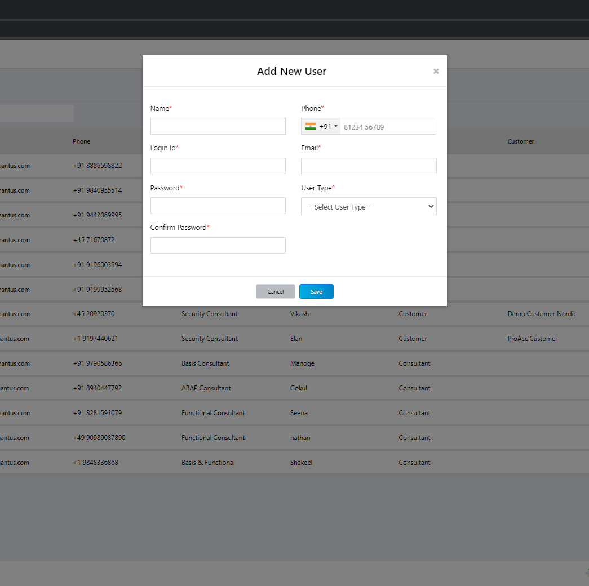
User Creation
Add , Update & Delete User → Admin Controller → Store procedure SP_User
To Add Type :userCreate
To Update Type :userUpdate
To Delete Type :DeleteUserById

Slide 12
Configuration

Slide 13
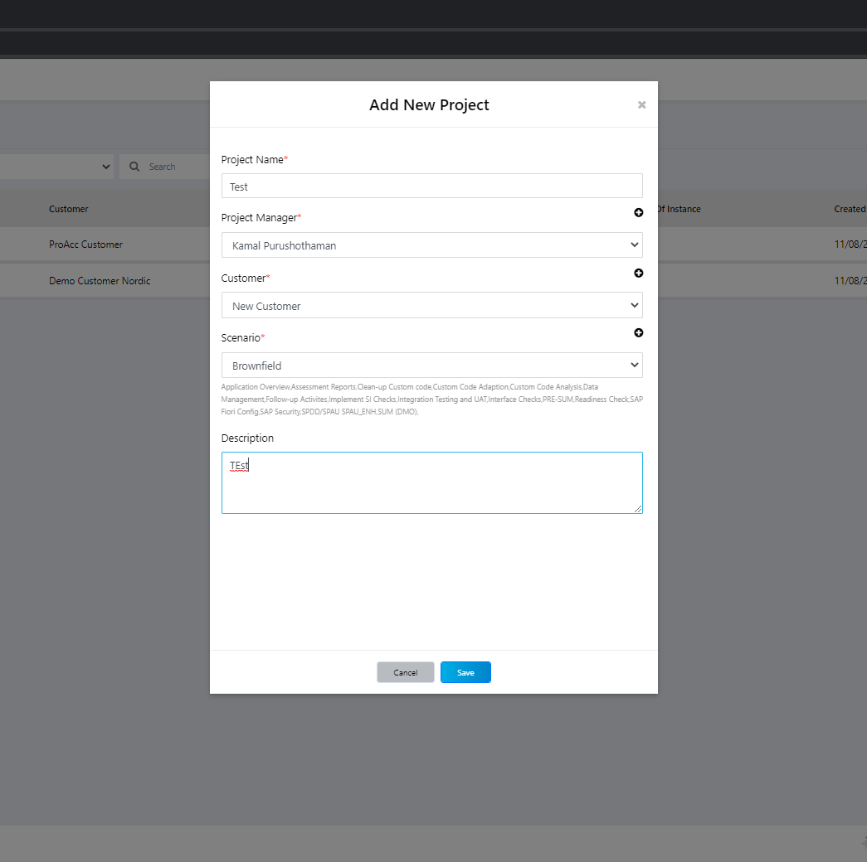
Project creation
Add , Update & Delete project → Admin Controller → Store procedure SP_Project
To Add Type :CreateProject
To Update Type :UpdateProject
To Delete Type :Delete
To delete a project, it should have any active instance in it

Slide 14
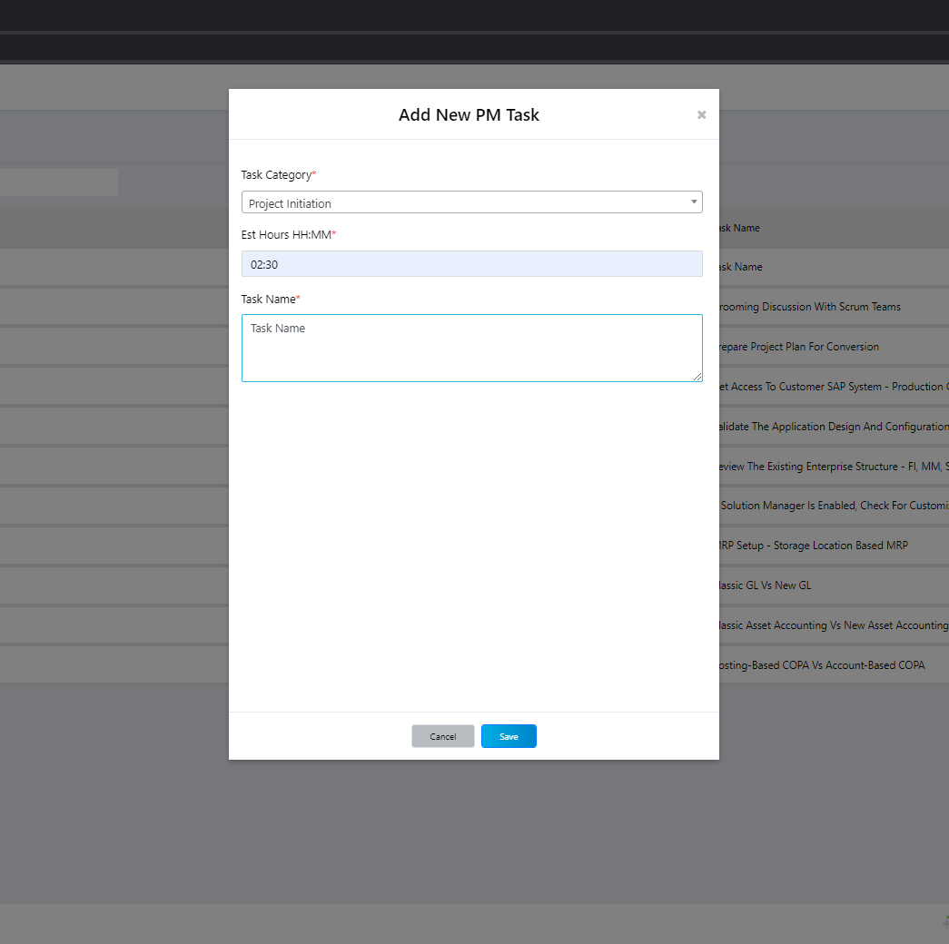
PM Task creation
Add , Update & Delete PMtask → Admin Controller → Store procedure SP_PMTask
To Add Type :PMAdd
To Update Type :PMUpdate
To Delete Type :Delete

Slide 15
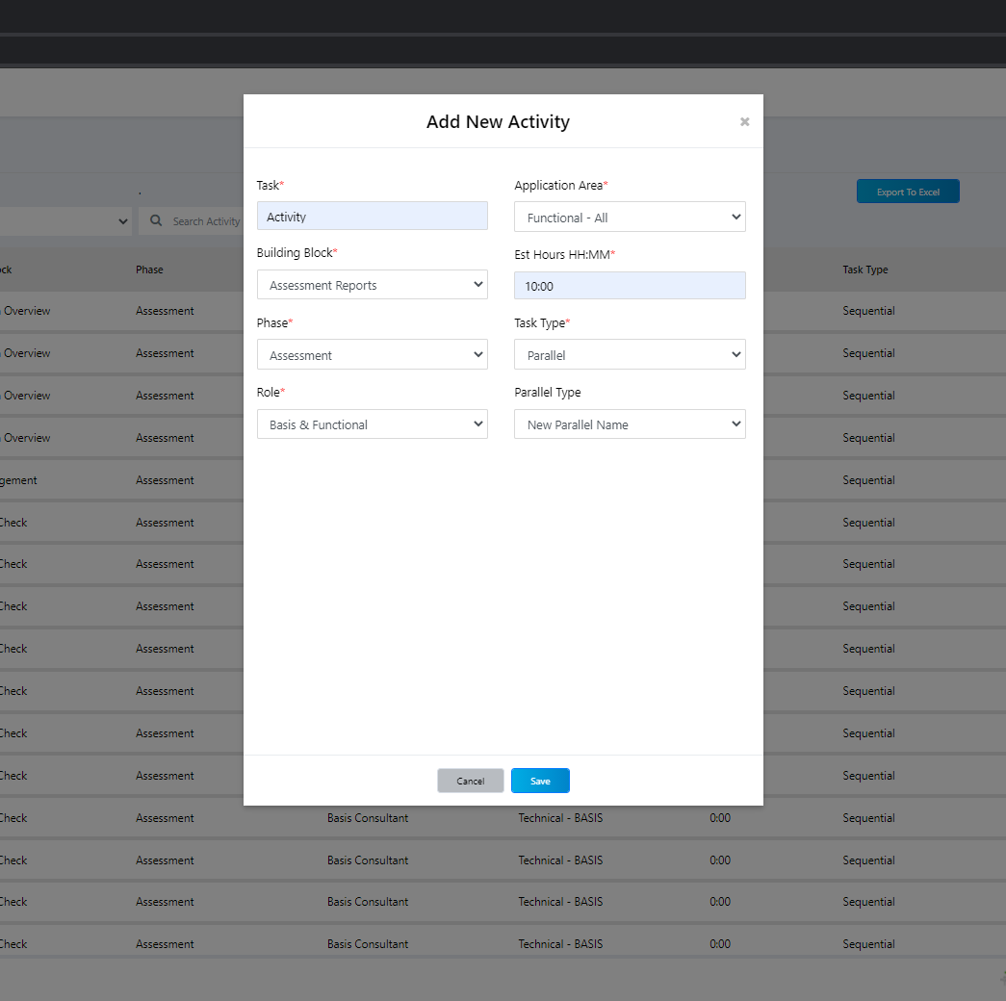
Activity Task creation
Add ,Update & Delete Activity → Admin Controller → Store procedure SP_Activity
To Add Type : ADD
To Update Type : Update
To Delete Type : DeleteActivityById
By default you need to upload once activity excel to add a activity

Slide 16
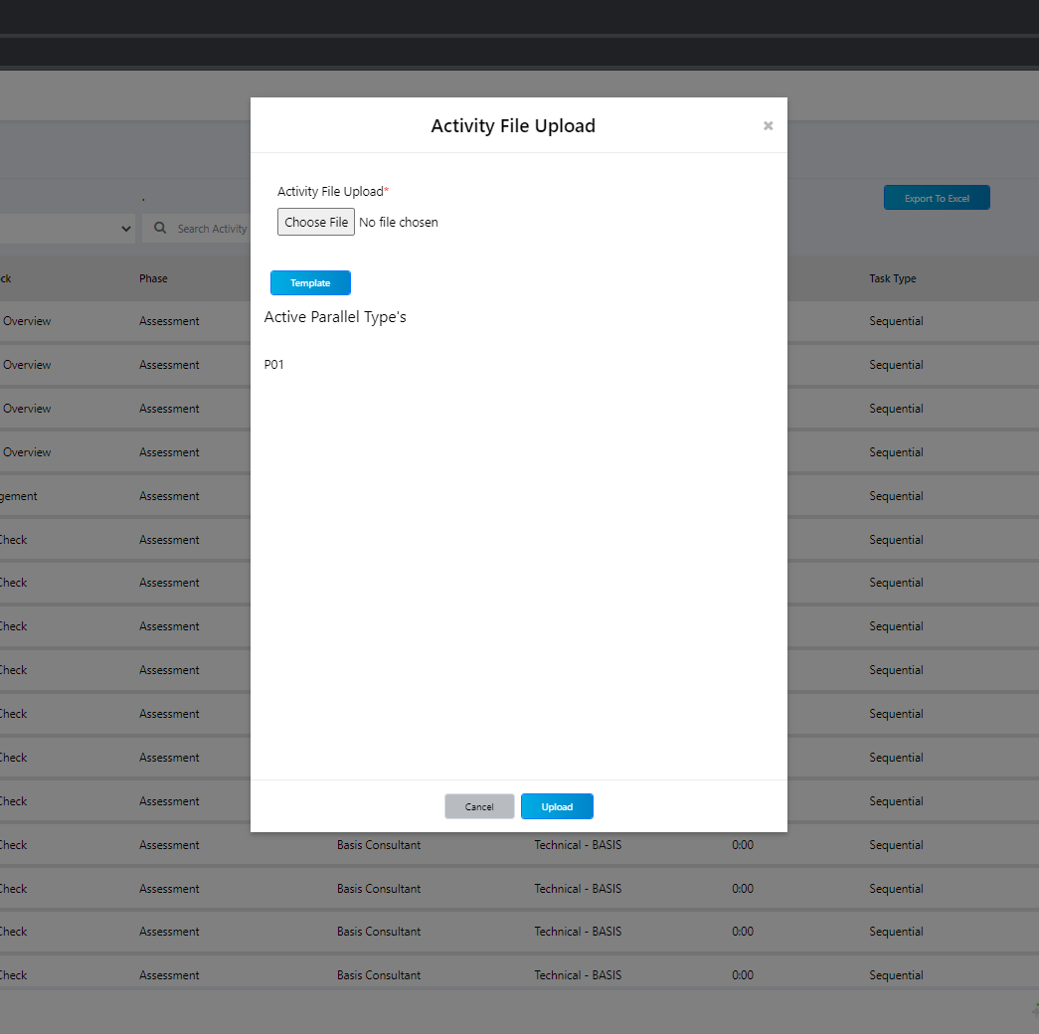
Activity Upload Excel
Admin Controller → ActivityFileUpload → Process_ActivityMaster →Store procedure SP_FileUpload
To Add Type : up_ActivityFileUpload

Slide 17
Miscellaneous

Slide 18
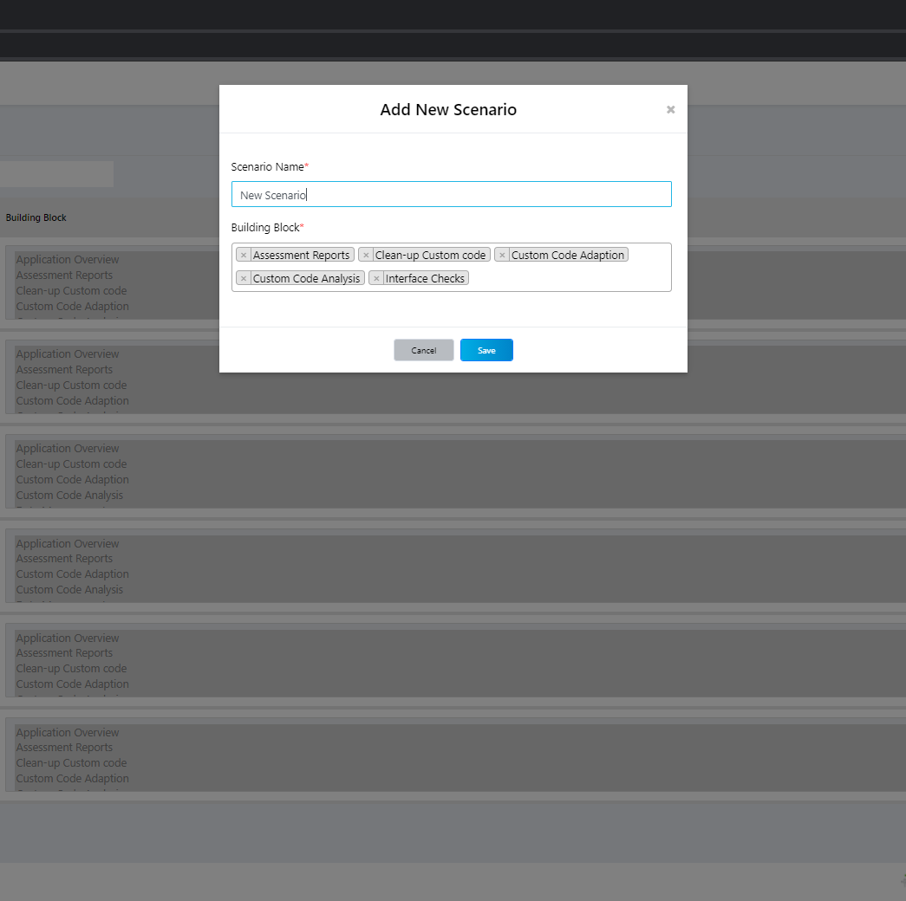
Scenario creation
Add , Update & Delete Scenario → Admin Controller → Store procedure SP_Scenario
To Add Type :CreateScenario
To Update Type :UpdateScenario
To Delete Type :Sp_DeleteScenario
Building Block is a static data which is hard cored in the database

Slide 19
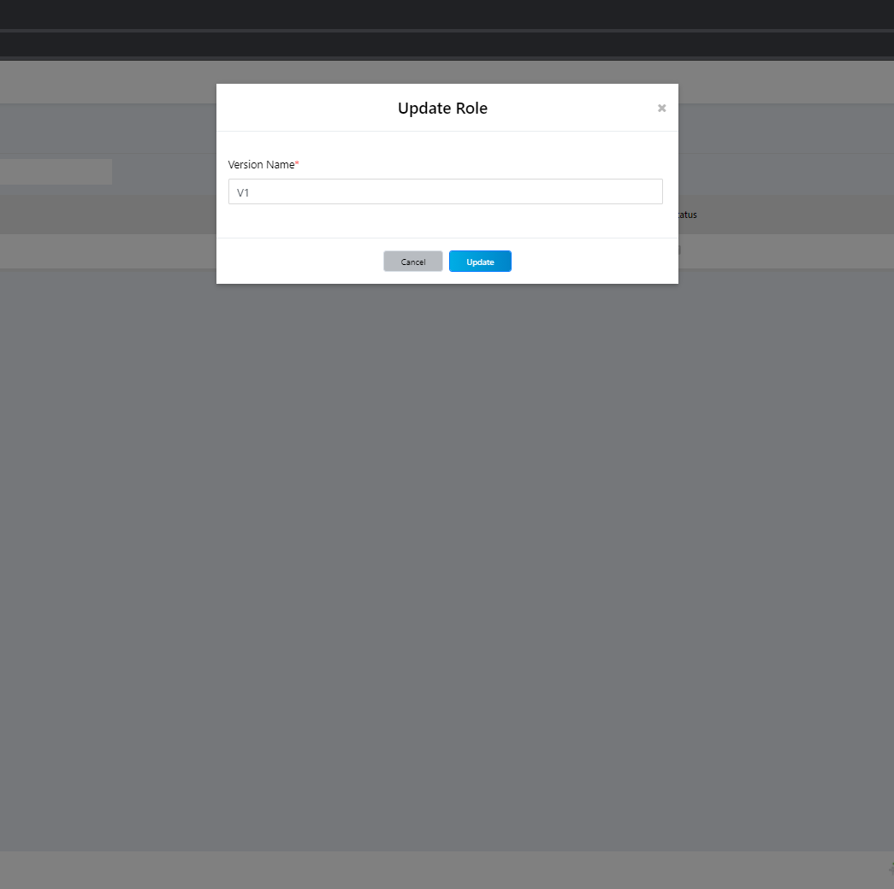
Version creation
Update Version → Admin Controller → Store procedure SP_Version
To Update Type :UpdateVersion
This Version will automatically create each time we upload Activity excel in the configuration tab

Slide 20
Role creation
Add , Update & Delete Role → Admin Controller → Store procedure SP_Role
To Add Type :CreateRole
To Update Type :UpdateRole
To Delete Type :Delete
To delete a role, it should not be mapped with in any project
As off today all delete operation was disabled

Slide 21
Reports

Slide 22
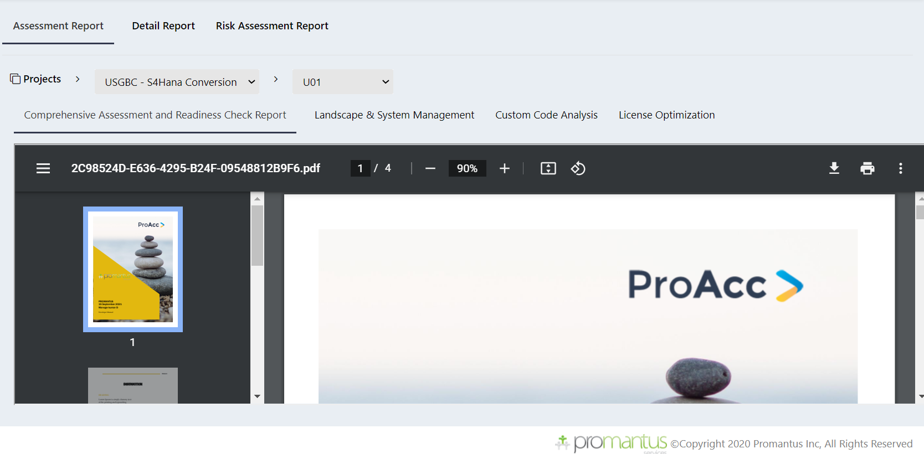
Reports Assessment
Home Controller → ActivityFileUpload → Process_ActivityMaster →Store procedure SP_FileUpload
To Type : GetPMuploadlist

Slide 23
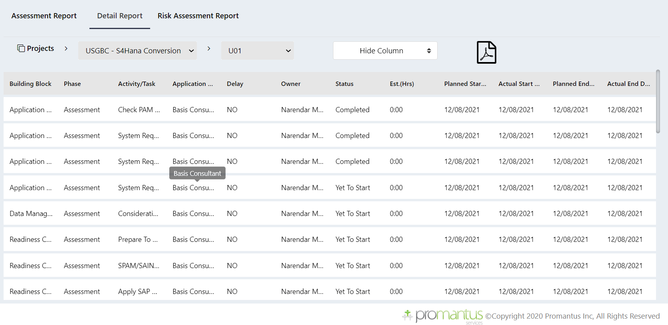
Detail Report
Home Controller → Store procedure SP_GetReportData
To Type : GetReportData

Slide 24
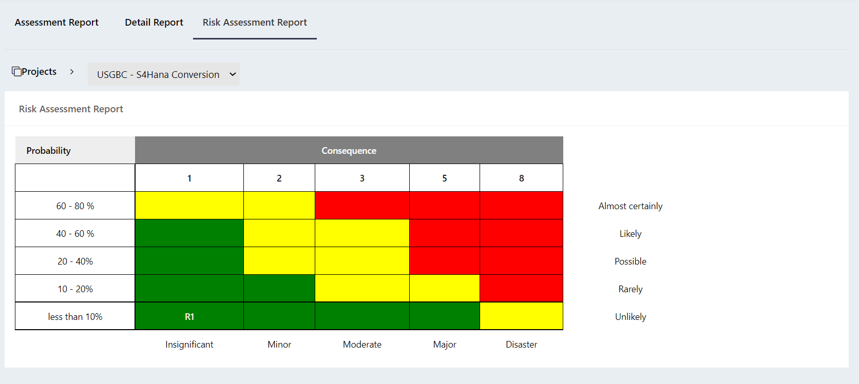
Risk Assessment
Home Controller → Store procedure SP_PMTask
To Type : GetRiskAssessmentDiagram

Slide 25
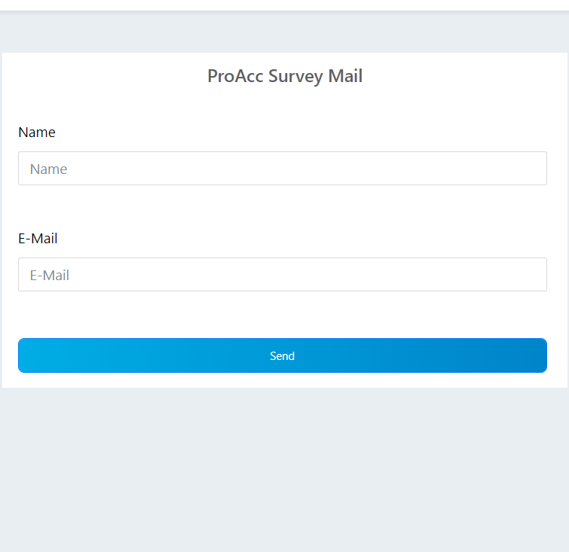
PROACC Survey Mail
Home Controller → Store procedure SP_Mail
To Type : SendCustomerMail

Slide 26
Project Manager
Dashboard
PM
Progress View
Readiness check
Task Monitoring
Reports
Issue Tracking
PROACC Survey Mail

Slide 27

Project Manager

Slide 28
Dashboard
As we seen in the Dashboard from Admin login same will be displayed.
Data will be respect to user logged in (Project Manager user and project )

Slide 29
PM

Slide 30
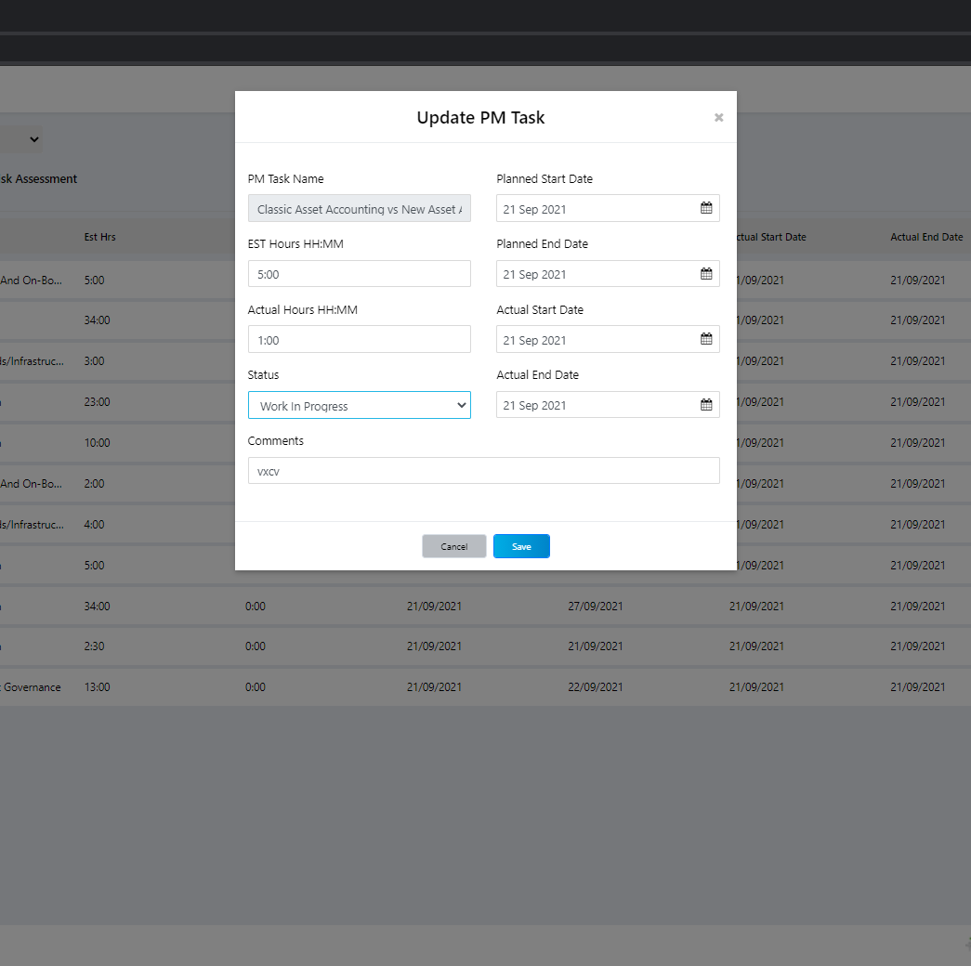
PM Task Monitor
Select Project → PM Pull→PMController → Store procedure SP_PMTask
To Pull Type :GetPMTask
To Read Type :GetPMTask1
To Update Type : UpdatePMTaskMonitor

Slide 31
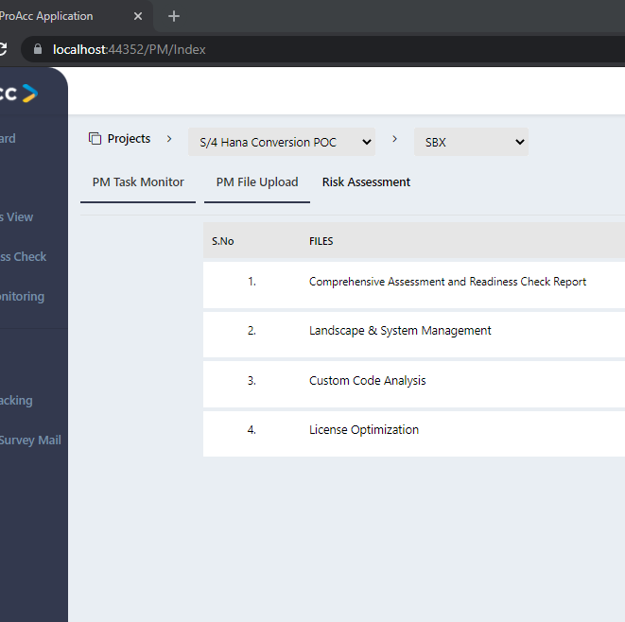
PM File upload
Select Project & instance → Add/Update→PMController → Store procedure SP_FileUpload
To Upload Type :up_PMupload

Slide 32
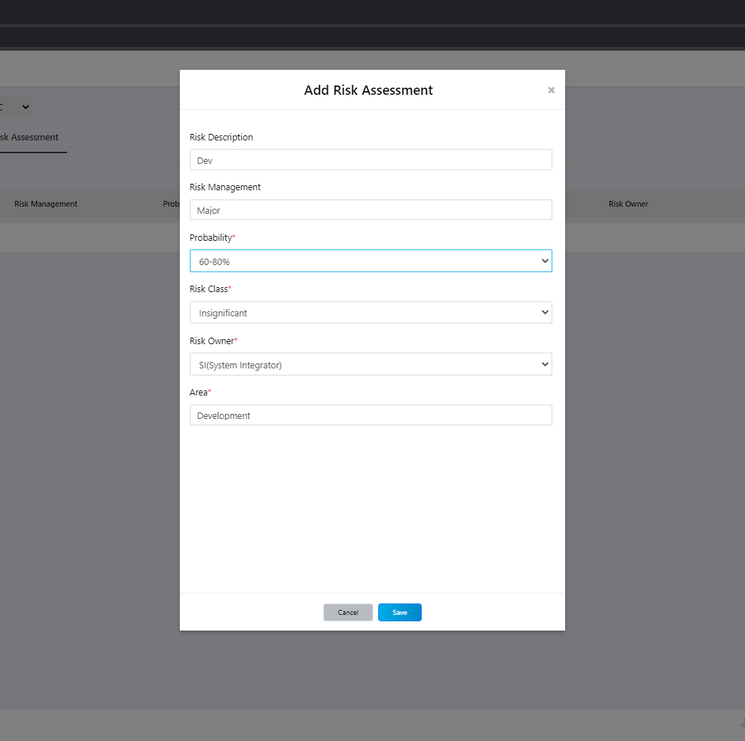
Risk Assessment
Select Project & instance → Add → PMController → Store procedure Name SP_PMTask
To AddType :SubmitRiskAssessment

Slide 33
Progress View

Slide 34
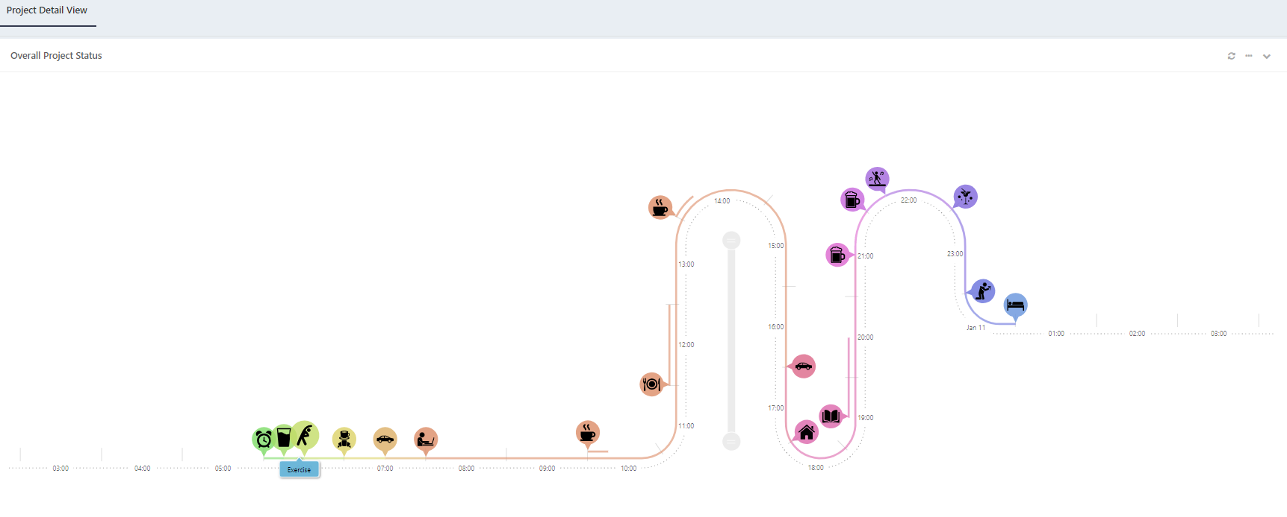
Progress view Overall Project Status
Just Suggested need more details to processed
Id ChartDiv_Project_Status

Slide 35
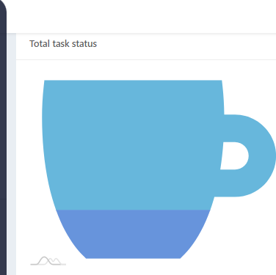
Progress view Total Task status
Select Project & instance → Add → PMController → Store procedure Name SP_ReadinessReport
To AddType :ReadinssChaeckOrStatus

Slide 36
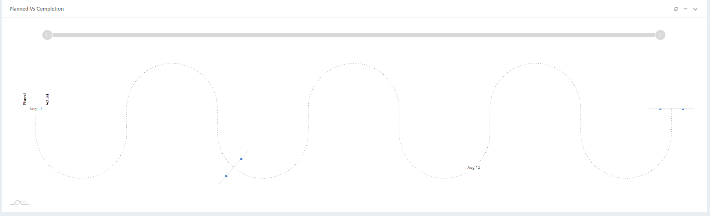
Progress view Planed Vs Completion
Select Project & instance → PMController → Store procedure Name SP_ReadinessReport
To AddType :PlannedVsActual

Slide 37
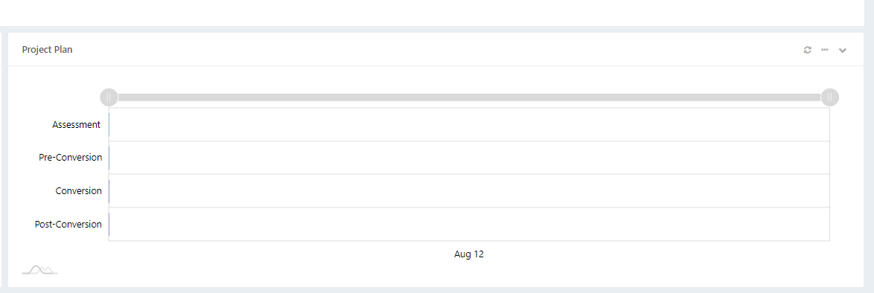
Progress view Project Plan
Select Project & instance → PMController → Store procedure Name SP_ReadinessReport
To AddType :Planned_Dates

Slide 38
Readiness check

Slide 39
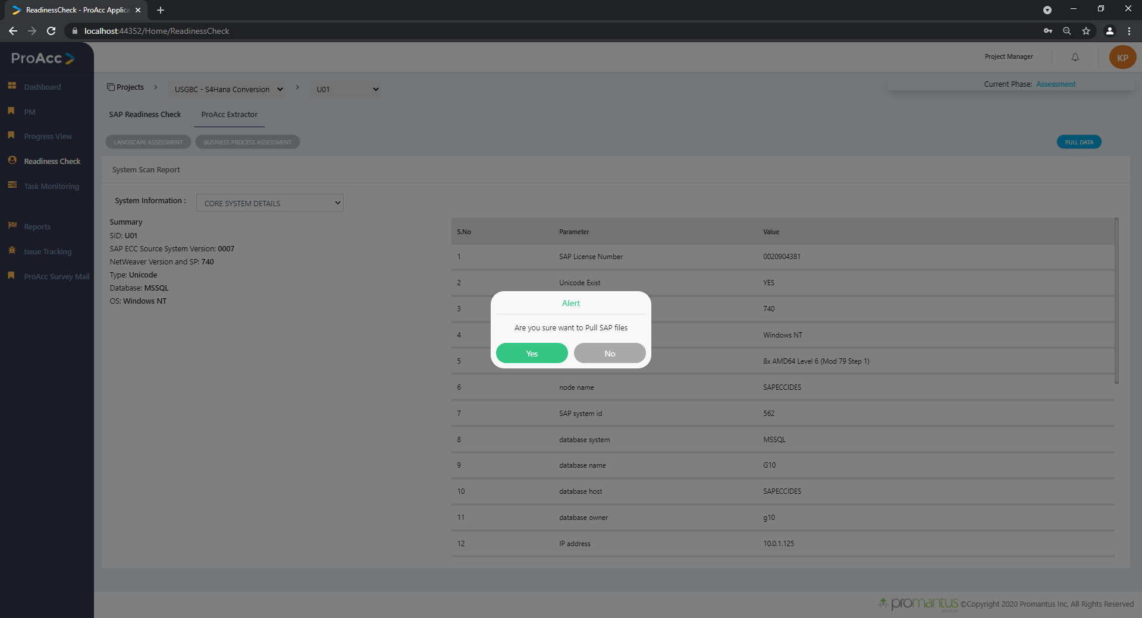
Readiness check ProAcc Extractor Landscape & Business process
Select Project & instance → HomeController GetSAPTables → Store procedure Name SP_Instance
To Add Type : SetSapTables
Table like SalesDocuments, BillingDocuments, OrderDocuments, MaterialityScore, SAPInput_RFCFM, SAPInput_INSTALLEDSOFTWARECOMPONENT, SAPInput_INSTALLEDPRODUCTVERSIONS, SAPInput_SFW5REPORT
This will pull the latest data from the SAP and save it in the database

Slide 40
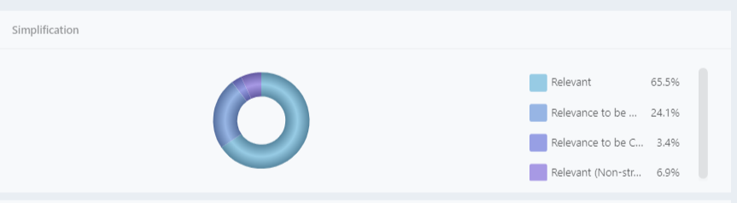

SAP Readiness check Simplification Report
Select Project & instance →
Add → Home Controller →
Store procedure Name SP_SimplificationReport
To Add Type : ALL

Slide 41
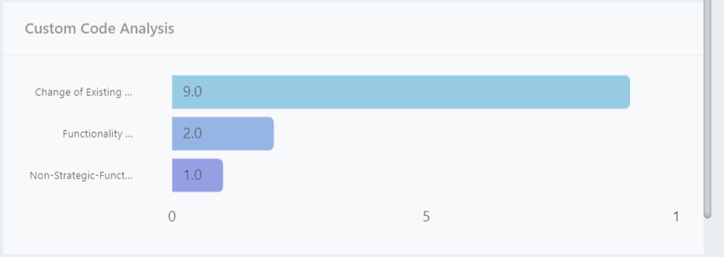
SAP Readiness check Custom Code
Select Project & instance →
Add → Home Controller →
Store procedure Name SP_ReadinessReport
To Add Type : CustomCode_Bar

Slide 42
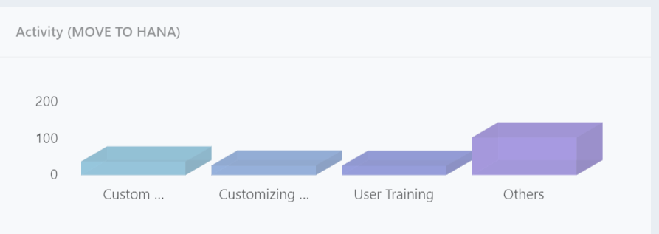
SAP Readiness check Activity(MOVE TO HANA)
Select Project & instance →
Add → Home Controller →
Store procedure Name SP_ReadinessReport
To Add Type : Activities_Bar1

Slide 43
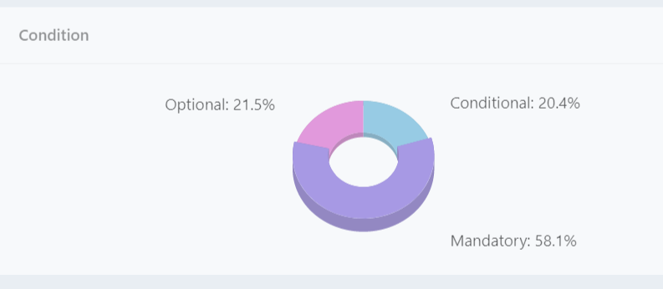
SAP Readiness check Condition
Select Project & instance →
Add → Home Controller →
Store procedure Name SP_ReadinessReport
To Add Type : Activities_Donut

Slide 44
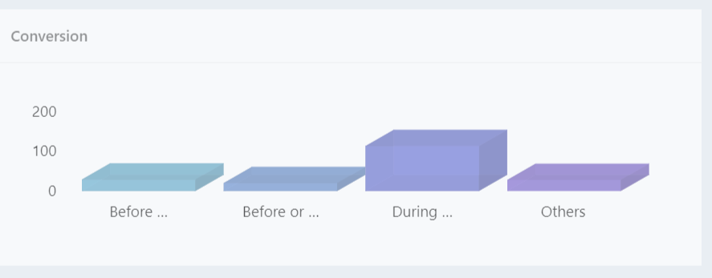
SAP Readiness check Conversion
Select Project & instance →
Add → Home Controller →
Store procedure Name SP_ReadinessReport
To Add Type : Activities_Bar2

Slide 45
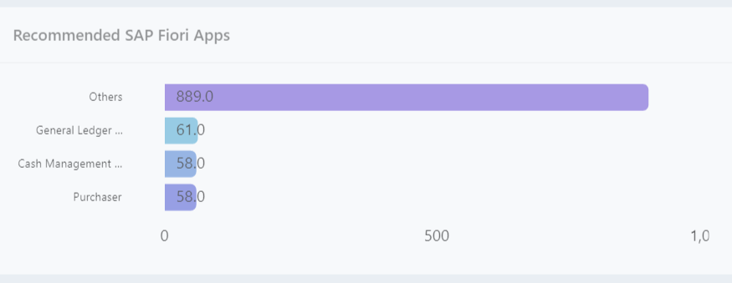
SAP Readiness check Recommended SAP Fiori Apps
Select Project & instance →
Add → Home Controller →
Store procedure Name SP_ReadinessReport
To Add Type : Fiori_Bar

Slide 46
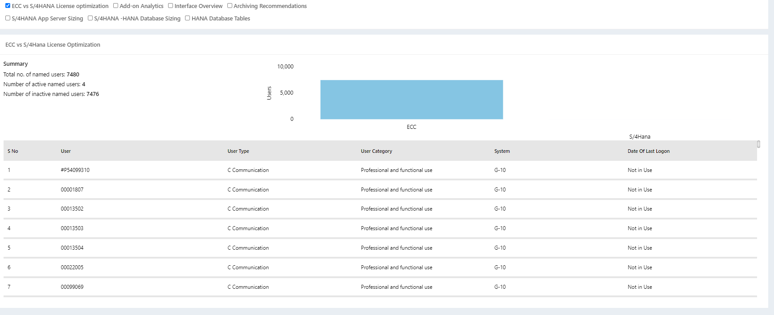
SAP Readiness check ECC vs S/4HANA License optimization
Select Project & instance →
Add → Home Controller →
Store procedure Name SP_ReadinessReport
To Chart Type : ECC_HanaCount
To Table Type: ECC_HanaCount_Table

Slide 47
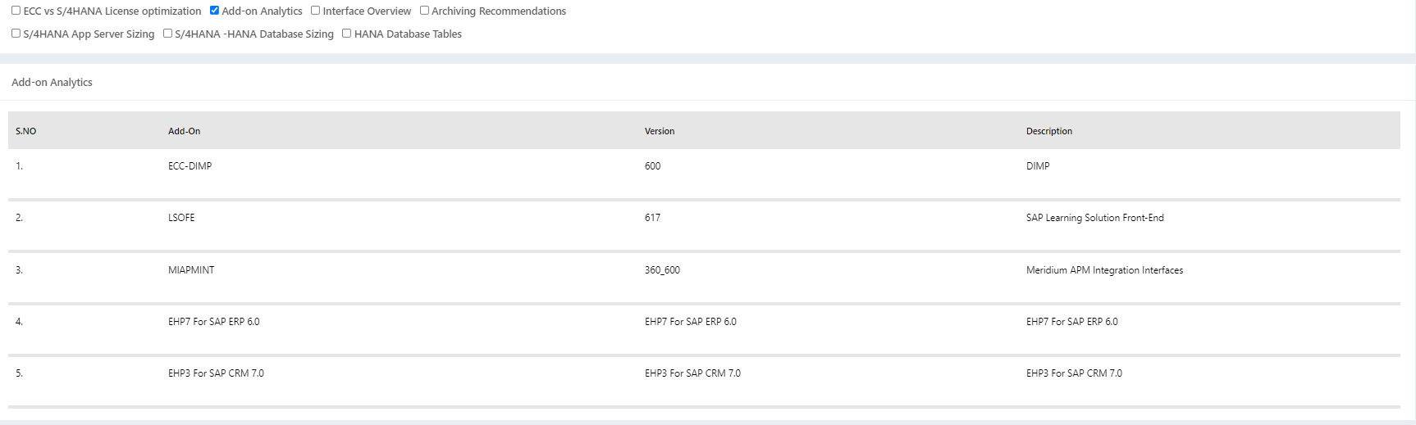
SAP Readiness check Add-on Analytics
Select Project & instance →
Add → Home Controller → This item TBD
Currently it's been hard cored

Slide 48
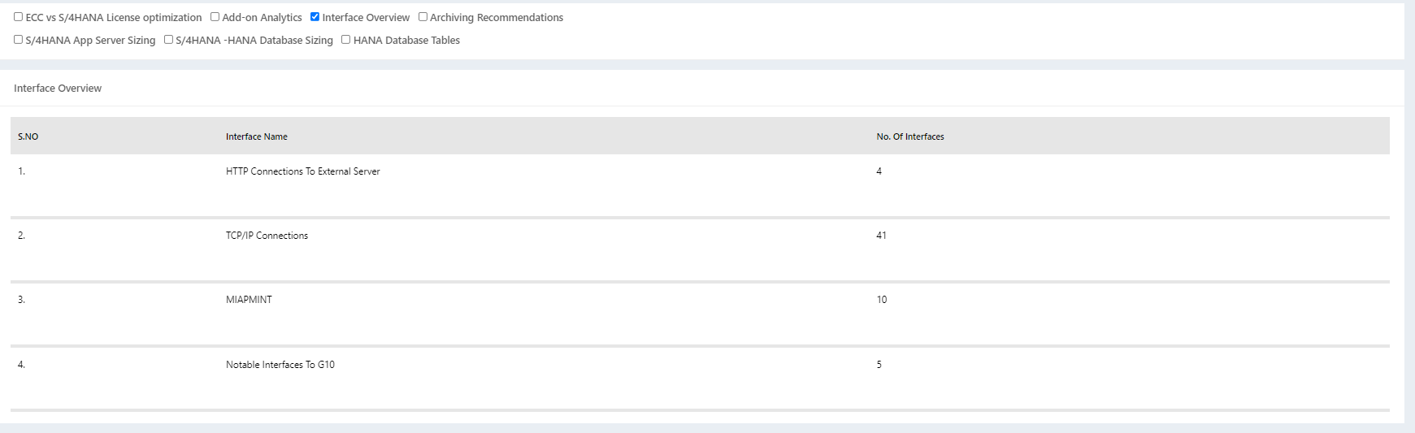
SAP Readiness check Interface Overview
Select Project & instance →
Add → Home Controller → This item TBD
Currently it's been hard cored

Slide 49
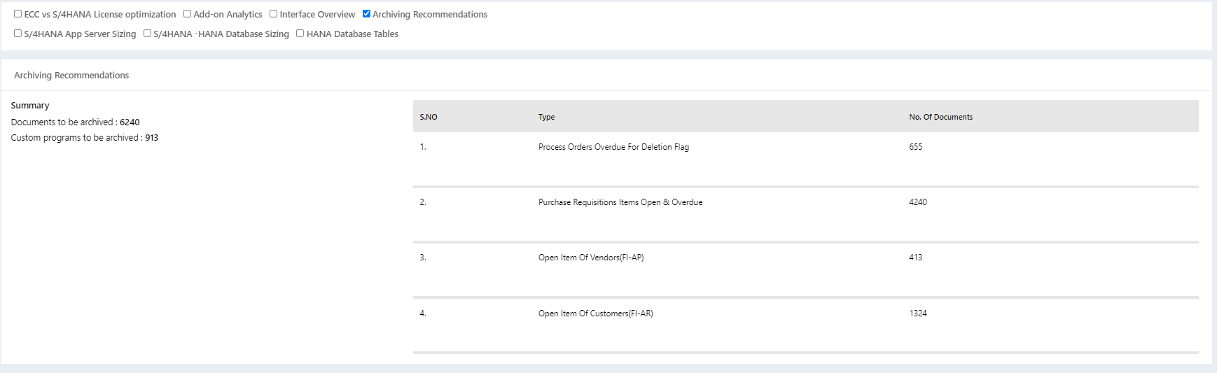
SAP Readiness check Archiving Recommendations
Select Project & instance →
Add → Home Controller → This item TBD
Currently it's been hard cored

Slide 50
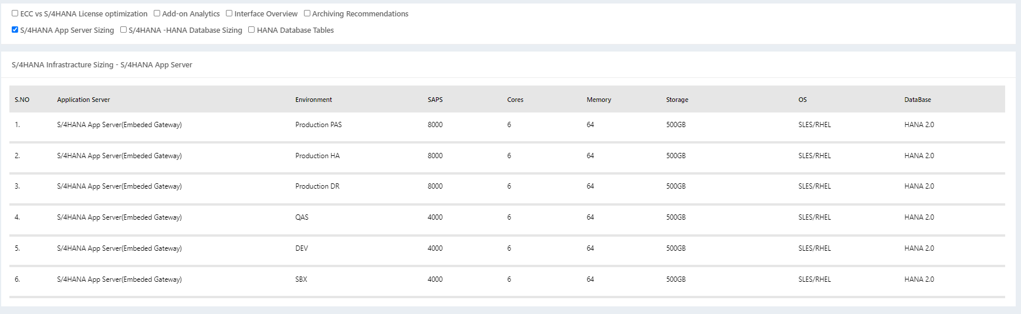
SAP Readiness check S/4HANA Infrastructure Sizing Server
Select Project & instance →
Add → Home Controller → This item TBD
Currently it's been hard cored

Slide 51
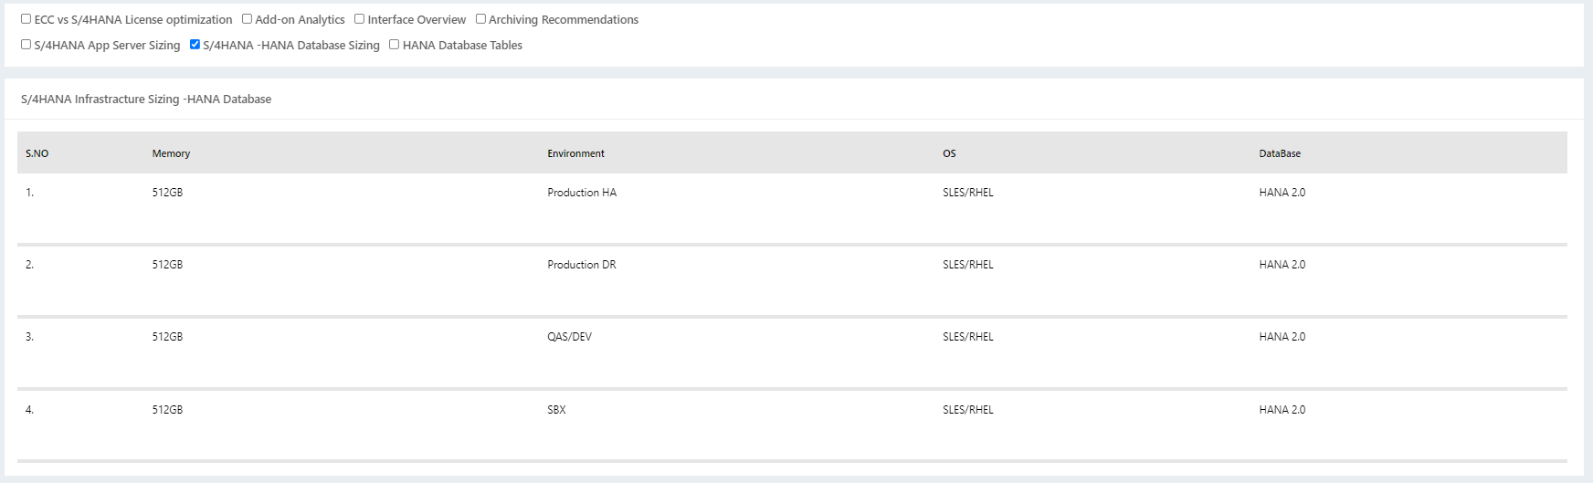
SAP Readiness check S/4HANA Infrastructure Sizing -Database
Select Project & instance →
Add → Home Controller → This item TBD
Currently it's been hard cored

Slide 52
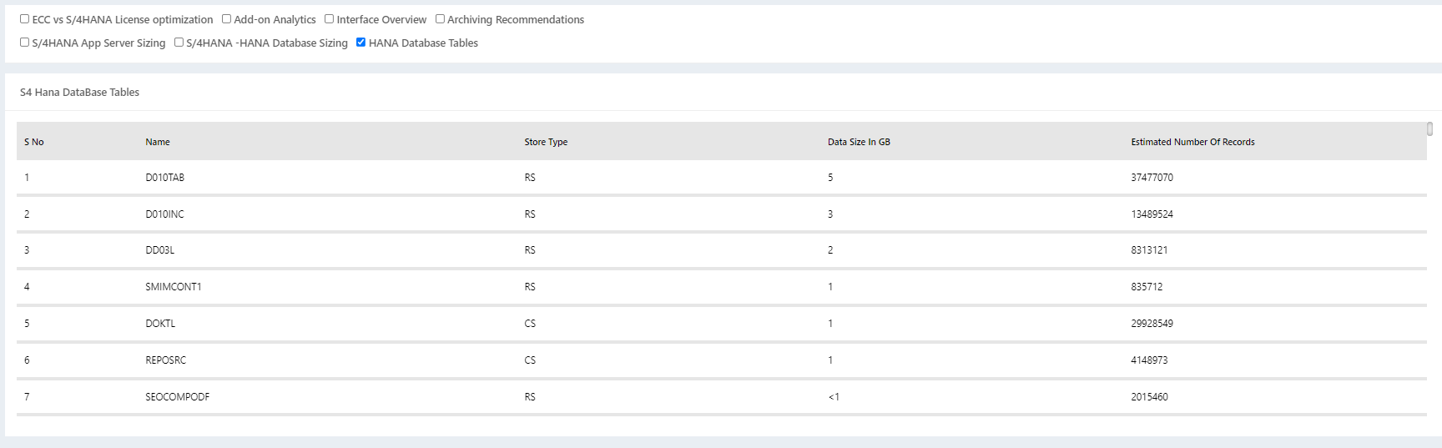
SAP Readiness check S4 Hana Data Base Tables
Select Project & instance →
Add → Home Controller →
Store procedure Name SP_ReadinessReport
To Table Type : hanaDatabaseReport

Slide 53
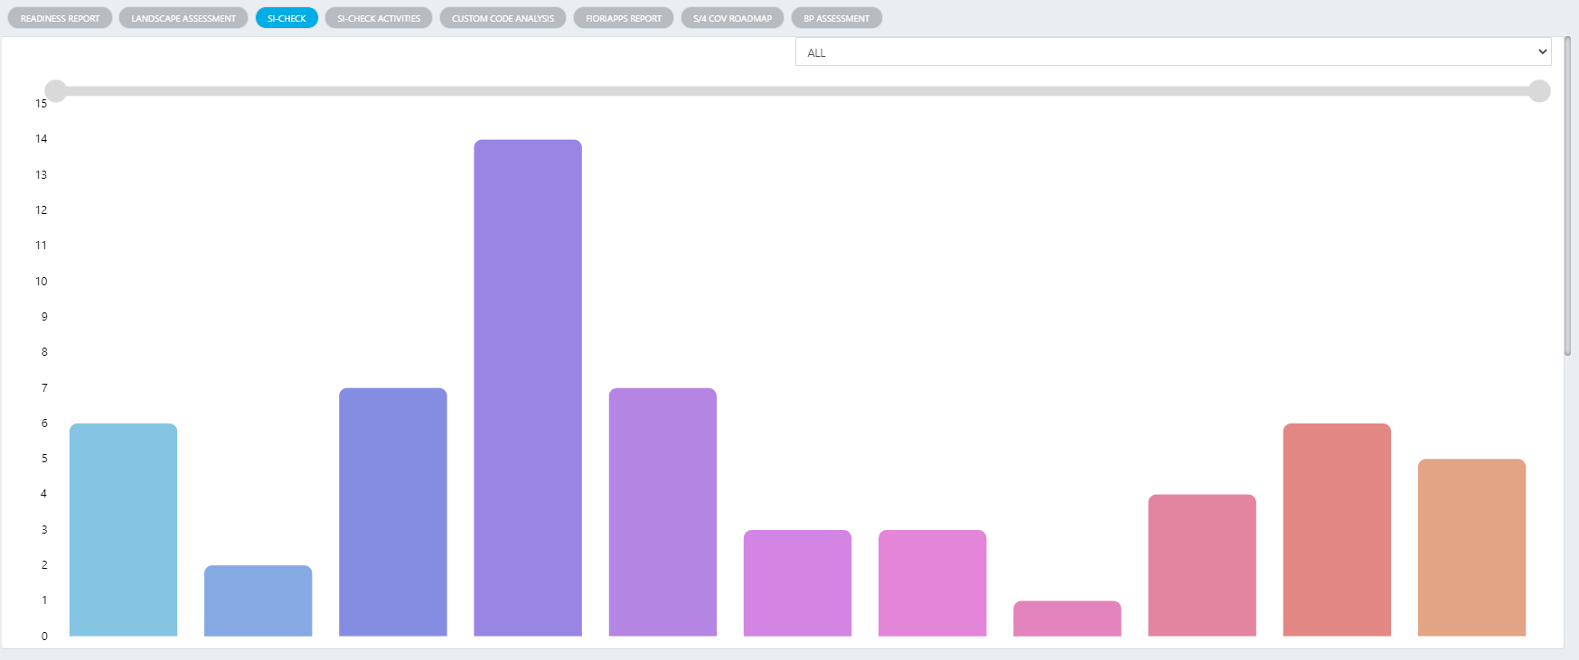
SAP Readiness check SI-Check
Select Project & instance →
Add → Home Controller →
Store procedure Name SP_SimplificationReport
To Table Type : ALL

Slide 54
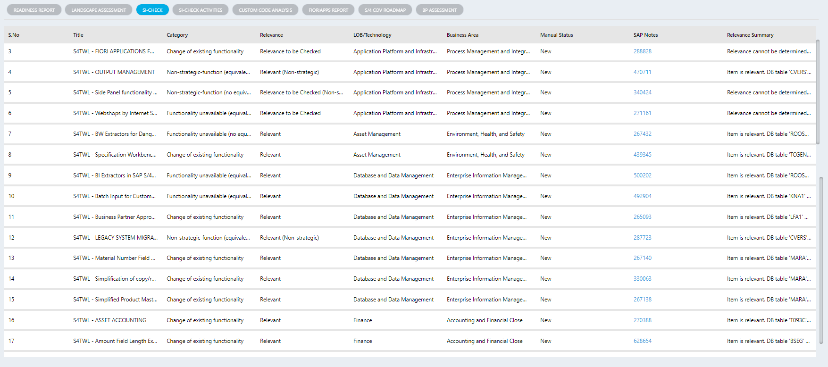
SAP Readiness check SI-Check
Select Project & instance →
Add → Home Controller →
Store procedure Name SP_SimplificationReport
To Table Type : SR_Table_All

Slide 55
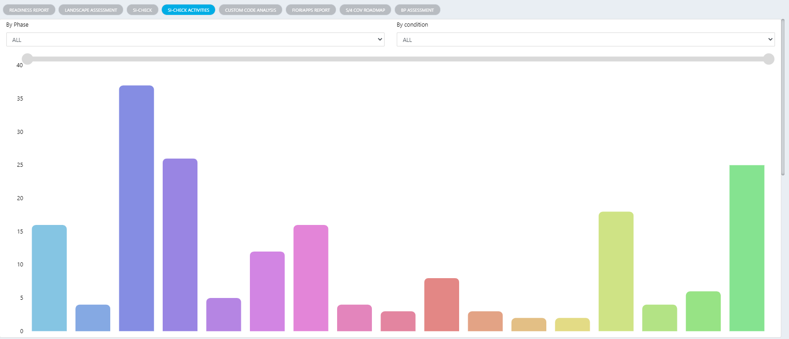
SAP Readiness check SI-Check Activities
Select Project & instance →
Add → Home Controller →
Store procedure Name SP_ActivitiesReport
To Table Type : ALL

Slide 56
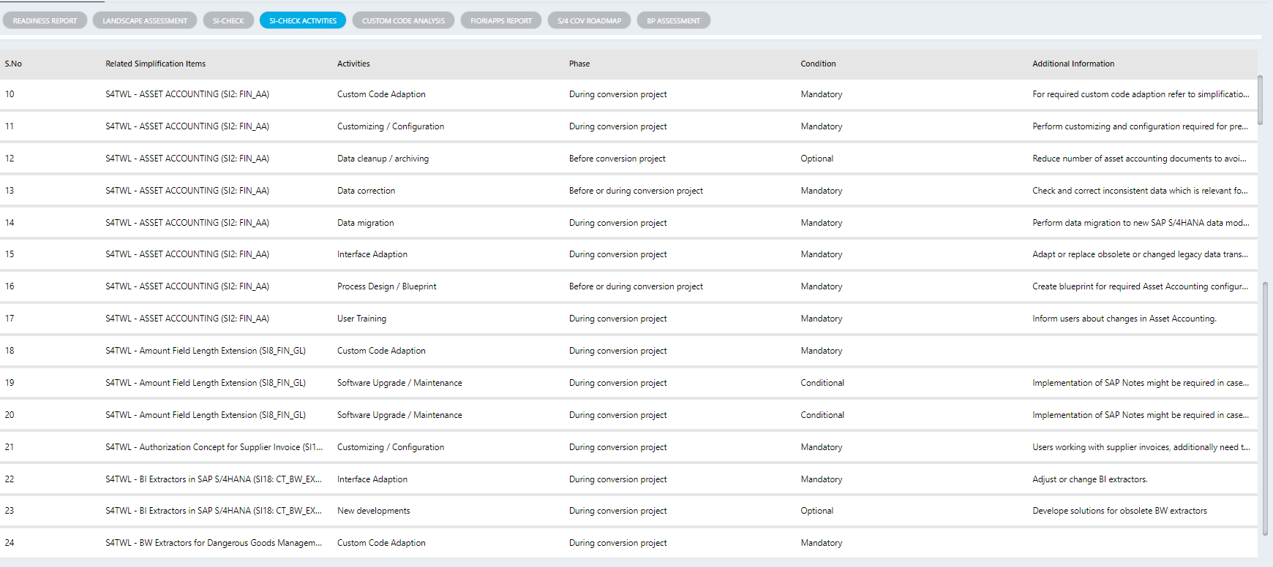
SAP Readiness check SI-Check Activities
Select Project & instance →
Add → Home Controller →
Store procedure Name SP_ActivitiesReport
To Table Type : ACT_Table

Slide 57
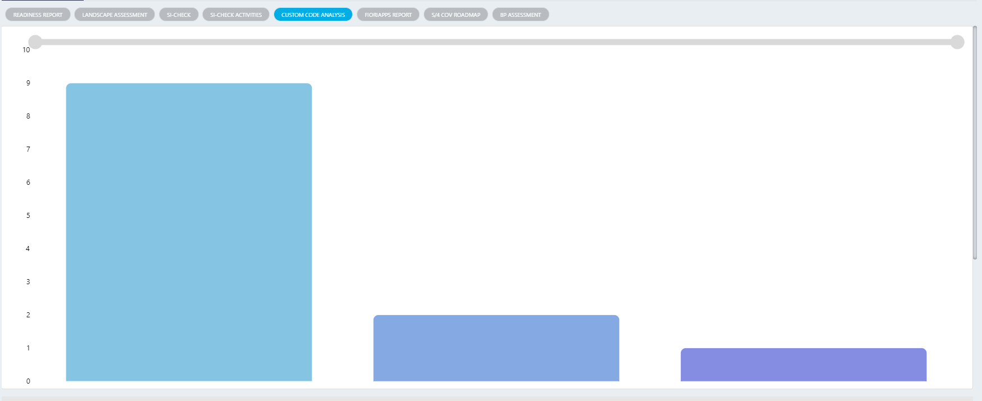
SAP Readiness check custom code analysis
Select Project & instance →
Add → Home Controller →
Store procedure Name SP_ReadinessReport
To Table Type : CustomCode_Bar

Slide 58
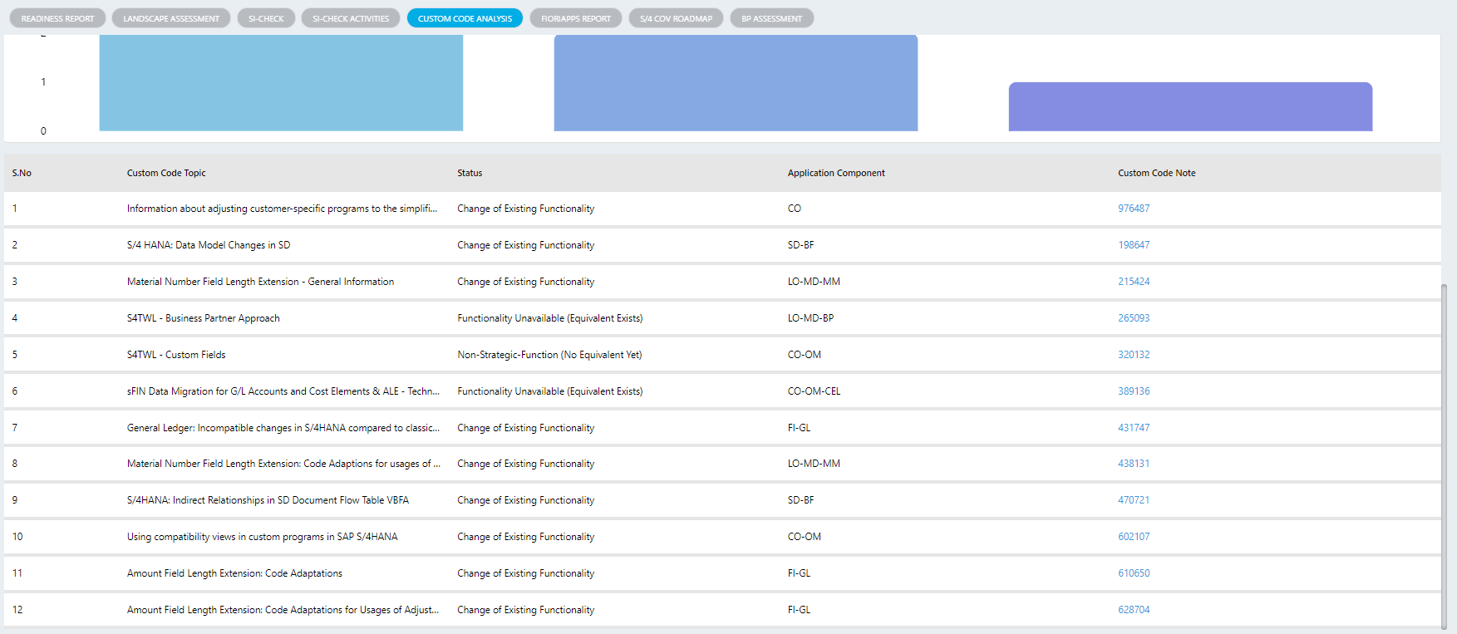
SAP Readiness check custom code analysis
Select Project & instance →
Add → Home Controller →
Store procedure Name SP_CustomCode
To Table Type : CustomTable

Slide 59
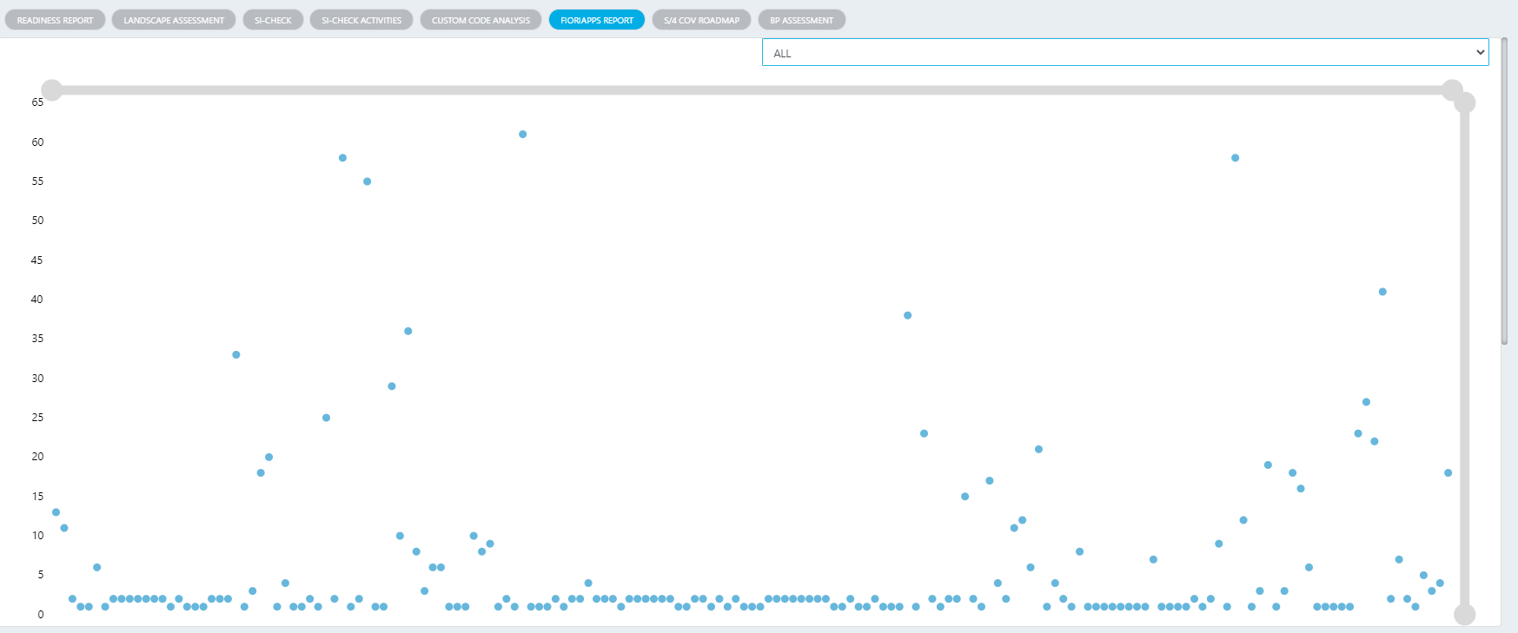
SAP Readiness check Fiori app’s Report
Select Project & instance →
Add → Home Controller →
Store procedure Name SP_FioriAppsReport
To Table Type : ALL

Slide 60
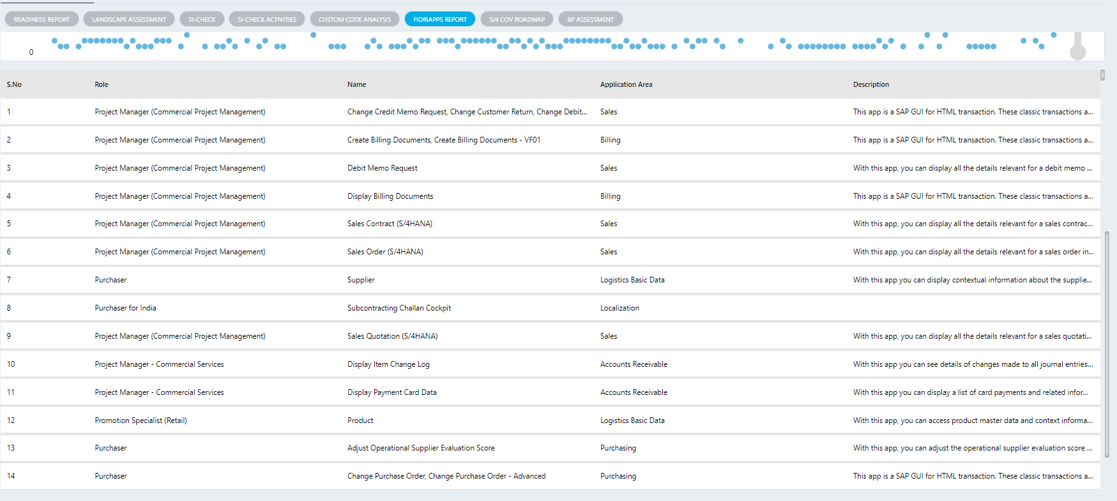
SAP Readiness check Fiori app’s Report
Select Project & instance →
Add → Home Controller →
Store procedure Name SP_FioriAppsReport
To Table Type : FioriApps_Table

Slide 61
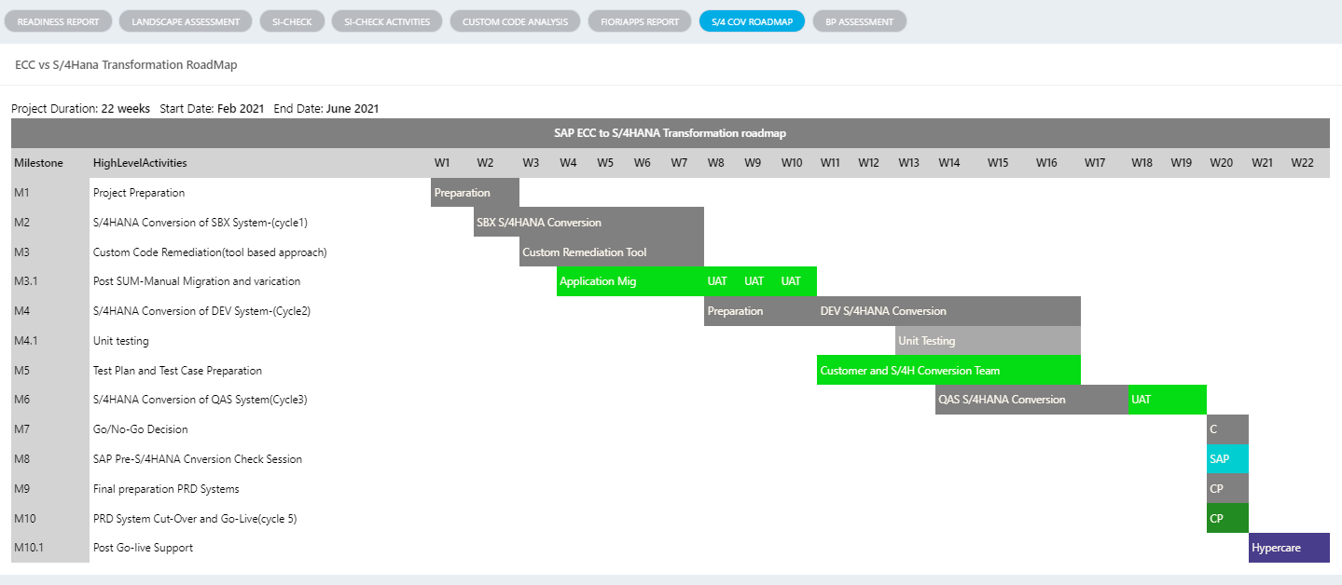
SAP Readiness check S/4 COV Roadmap
Select Project & instance →
Add → Home Controller → This item TBD
Currently it's been hard cored

Slide 62
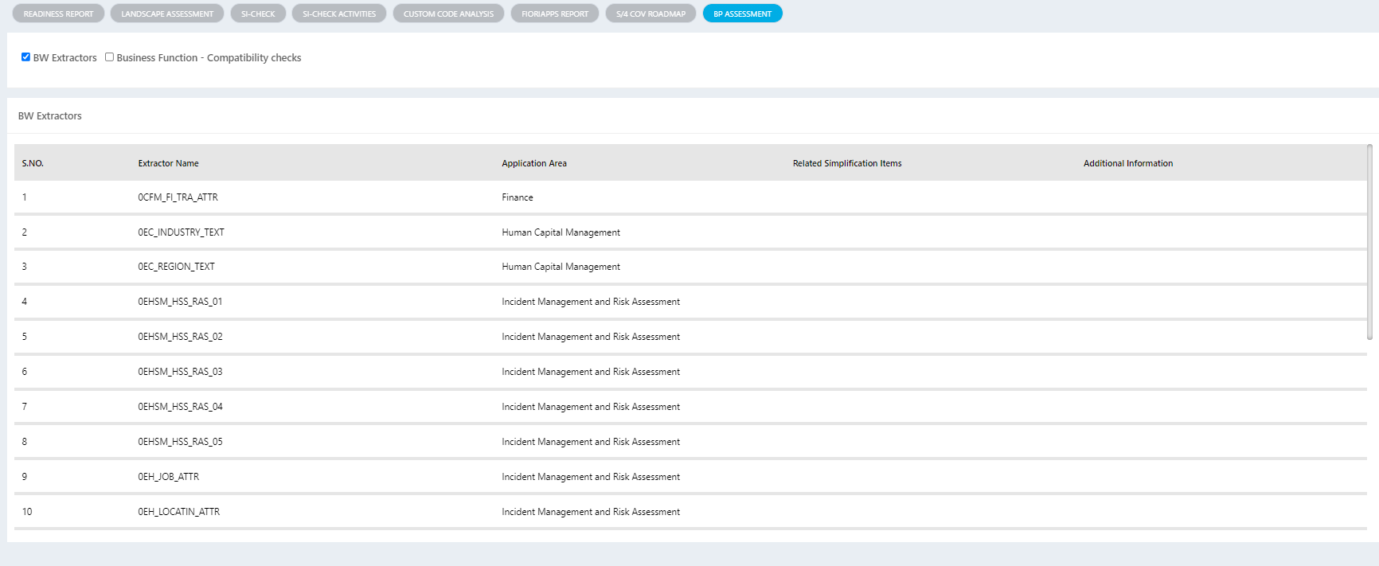
SAP Readiness check BP Assessment
Select Project & instance →
Add → Home Controller →
Store procedure Name SP_ReadinessReport
To Table Type : BwExtractors
Compatibility checks is Hard cored -TBD

Slide 63
Task Monitoring

Slide 64
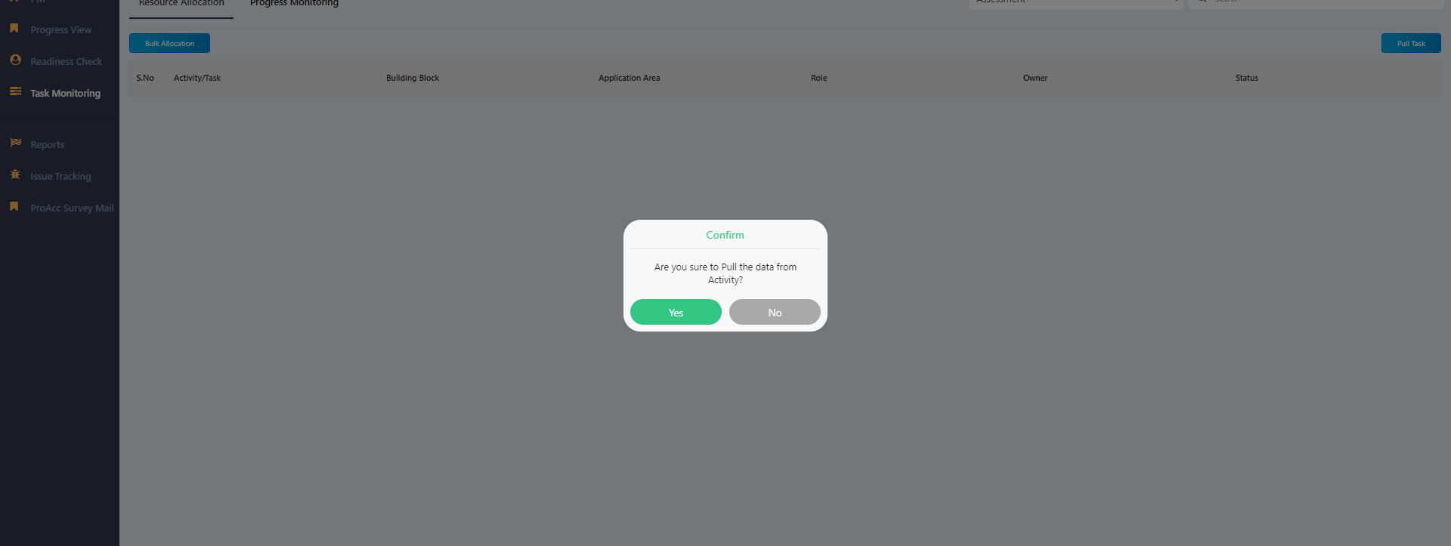
Task Monitoring Resource Allocation
Select Project & instance →
Add → Transaction Controller →
Store procedure Name SP_ResourceAllocation
To Table Type : GetResourceAllocationDataFromActivity
Yes To pull data from master activity to transaction table

Slide 65
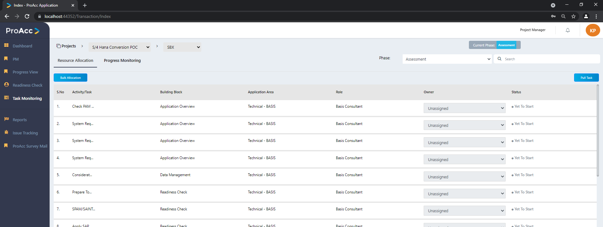
Task Monitoring Resource Allocation
Select Project & instance →
Add → Transaction Controller →
Store procedure Name SP_ResourceAllocation
To Table Type : GetResourceAllocationData

Slide 66
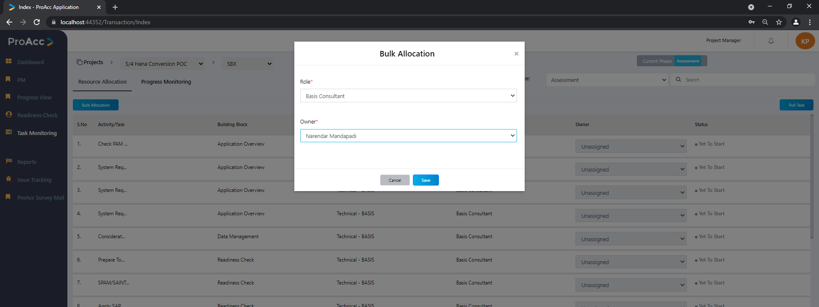
Task Monitoring Resource Allocation
Select Project & instance →
Add → Transaction Controller →
Store procedure Name SP_ResourceAllocation
To Table Type : GetBulkAllocateOwnerResourceAllocation

Slide 67
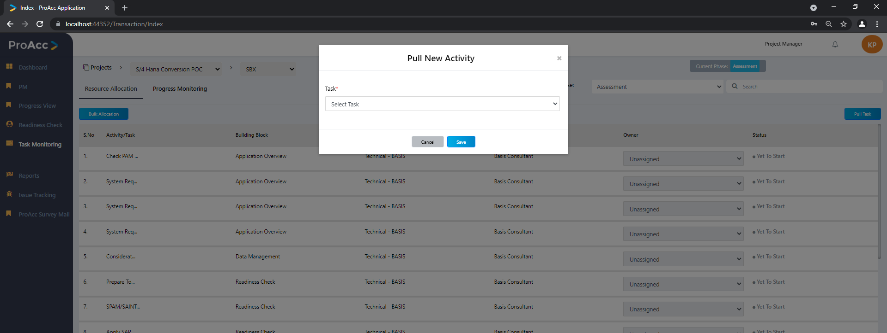
Task Monitoring Resource Allocation
Select Project & instance →
Add → Transaction Controller →
Store procedure Name SP_ProgressMonitor
To Table Type : AddResource

Slide 68
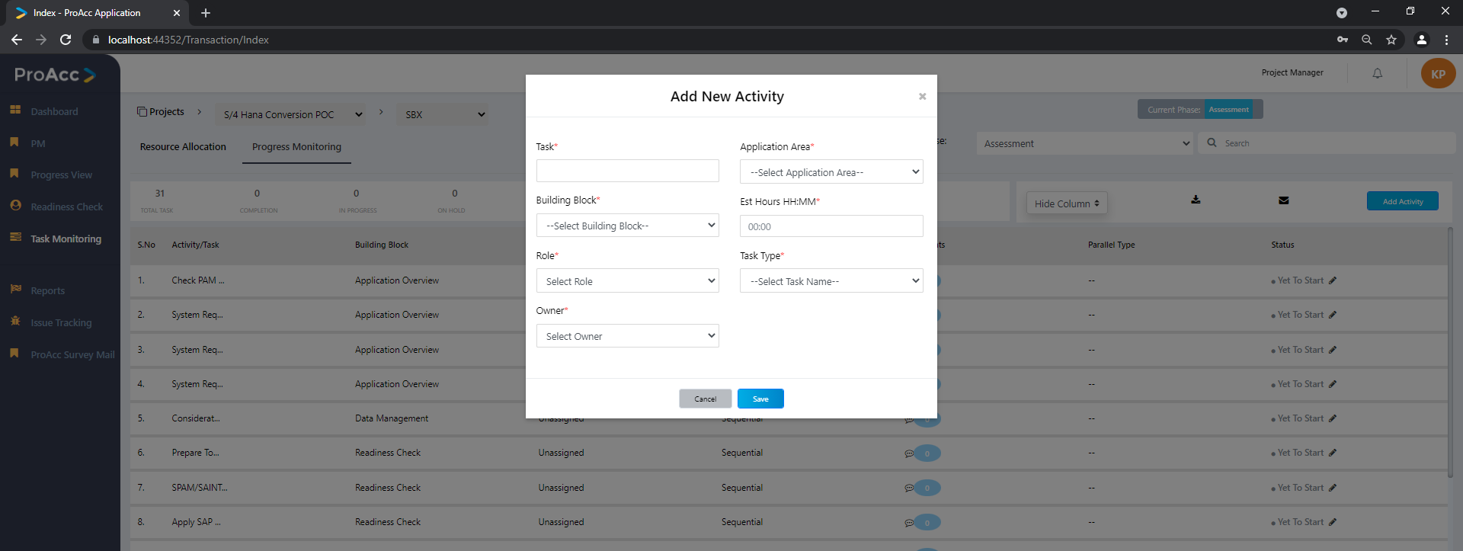
Task Monitoring Progress Monitoring
Select Project & instance →
Add → Transaction Controller →
Store procedure Name SP_ProgressMonitor
To Table Type :GetTask

Slide 69

Task Monitoring Progress Monitoring
Select Project & instance →
Add → Transaction Controller →
Store procedure Name SP_ProgressMonitor
To Table Type :UpdateTask

Slide 70
Reports
Select Project & instance →
Same reports as such admin login

Slide 71
Issue Tracking

Slide 72

Issue Track
IssueTrack Controller → Store procedure SP_IssueTrack
To Type : Pull_PM_Data

Slide 73

SAP Issue Dump
IssueTrack Controller → Store procedure SP_IssueTrack
To Type : LoadSAPIssueTrack

Slide 74

SAP Issue Dump Upload
IssueTrack Controller → Store procedure SP_FileUpload
To Type : SAPIssueTrackUpload

Slide 75
Consultant
Dashboard
Analysis
Readiness check
Task Monitoring
Reports
Issue Tracking
PROACC Survey Mail

Slide 76
Dashboard
As we seen in the Dashboard from Admin login same will be displayed.
Data will be respect to user logged in (Project Manager user and project )

Slide 77
Analysis

Slide 78

Create Analysis
IssueTrack Controller → Store procedure SP_FileUpload
To Type :
up_Activities, up_Bwextractors up_CustomCode, up_HanaDatabaseTables, up_FioriApps, up_Simplification, up_up_SAPReadinessCheck, up_UserList

Slide 79

SAP File Upload
IssueTrack Controller → Store procedure SP_FileUpload
To Type :
up_RFCFM, up_BillingDocuments, up_OrderDocuments, up_SalesDocuments, up_ComplexityAnalysis, up_MaterialityScore

Slide 80
Readiness check
Select Project & instance →
With Respect to user login project and instance will be displayed.
What we seen project manager login all will remain same.

Slide 81
Task Monitoring

Slide 82

Task Monitoring Progress Monitoring
Select Project & instance →
Add → Transaction Controller →
Store procedure Name SP_ProgressMonitor
To Table Type :GetTask
Login user can edit the task which are assigned to him alone either in sequential or parallel

Slide 83
Reports
Select Project & instance →
Same reports as in admin login

Slide 84
Issue Tracking
Select Project & instance →
As shown in the project manager login

Slide 85
Customer
Dashboard
Readiness check
Task Monitoring
Reports
Issue Tracking
PROACC Survey Mail

Slide 86
Dashboard
As we seen in the Dashboard from Admin login same will be displayed.
Data will be respect to user logged in (Project Manager user and project )

Slide 87
Readiness check
Select Project & instance →
With Respect to user login project and instance will be displayed.
What we seen project manager login all will remain same.

Slide 88

Task Monitoring Progress Monitoring
Select Project & instance →
Add → Transaction Controller →
Store procedure Name SP_ProgressMonitor
To Table Type :GetTask
With Respect to user login project and instance will be displayed
What we seen project manager login all will remain same.
Customer can’t edit data

Slide 89
Reports
Select Project & instance →
Same reports as in admin login

Slide 90
Issue Tracking
Select Project & instance →
As shown in the project manager login

